Slide 1









Reviewify
Technical Σ

Slide 2



Table of contents
02
01
Problem
Solution
03
04
Role
Code

Slide 3





Problem Statement
There is no centralized, reliable platform for authentic college reviews, making it hard for students to access honest peer feedback. As a result, decisions are often based on marketing content rather than real student experiences.

Slide 4



Solution
Frontend &
Visualization
Data Collection
NLP & Analysis
Collected student reviews via Google Forms and preprocessed the data (cleaning, formatting, categorizing).
Used NLP to analyze sentiments and extract keywords. Generated a word cloud and sentiment breakdown.
Built a responsive website to display graphs, insights, and team info using HTML, CSS, and JS.

Slide 5
Roles
Utkarsh
Gaurav
Tanush
Team Leader
NLP Engineer
Data Collector
& Analyst
UI/UX Developer
Frontend Specialist
Ghanish
Shubham
UI/UX Developer
Frontend Specialist
UI/UX Developer
Frontend Specialist

Slide 6
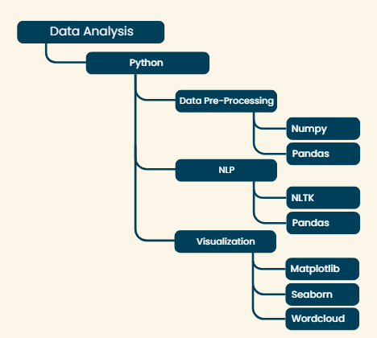

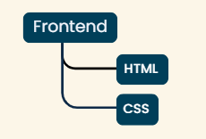


Code
Tech Stack:

Slide 7
Use Cases
Student Decision Support | Helps prospective students evaluate a college based on real peer feedback across parameters like faculty, infrastructure, and curriculum.
College Administration Insights | Enables institutions to identify areas of improvement using aggregated student sentiment and graphical analytics.
Alumni Feedback Collection | Collects and visualizes alumni reviews to guide current students and assist in long-term campus development.
Trusted Peer Reviews for New Applicants | Provides new applicants with authentic, crowd-sourced insights from current students to make better-informed enrollment decisions.

Slide 8




Thanks!

